Slide 1
Engineering Mechanics Course code: 216U06C104 Module 3: Centroid of Wires and Lamina
3.1 Centroid of Wires/rods
3.2 Centroid of plane laminas: Plane lamina consisting of primitive
geometrical shapes.
Dr. Manish Deo
Assistant Professor
Department of Mechanical Engineering
Room – A301
e-mail – manish.deo@somaiya.edu
Mob. No. 97187960203

Slide 2
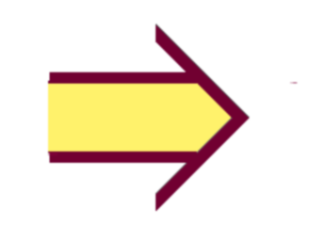
Learning Outcomes
At the end of lecture learner will be able to calculate the centroid of the lamina

Slide 3
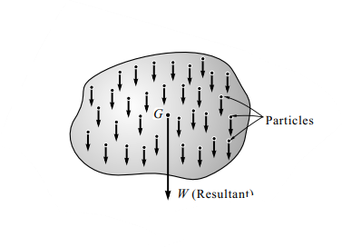
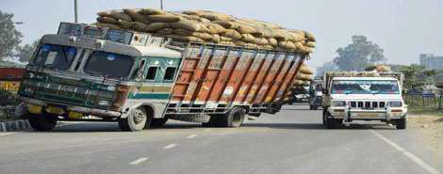
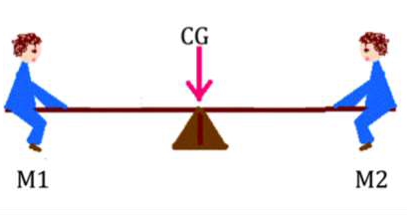
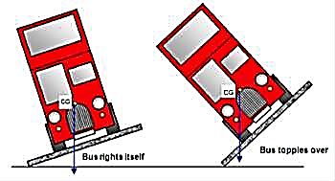
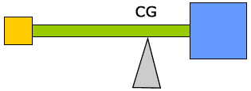
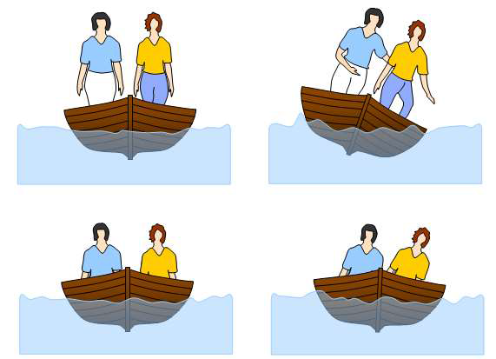
Centre of Gravity of a body
Centre of gravity of body^{[1]}

Slide 4
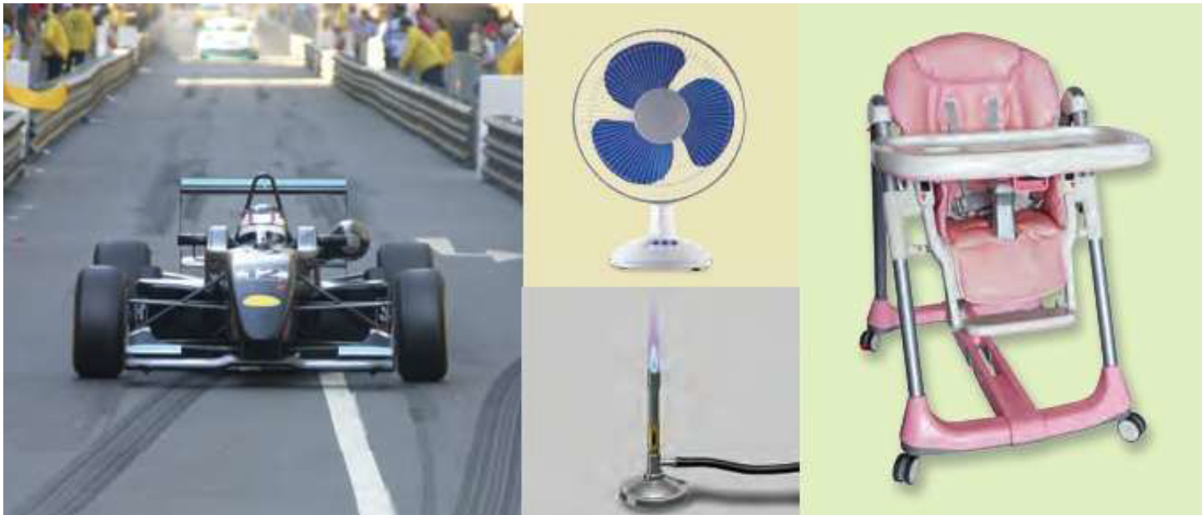
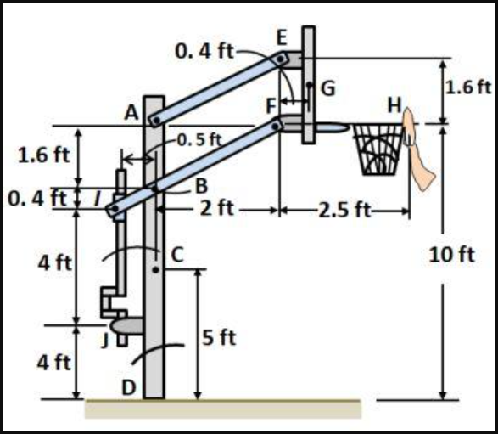
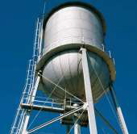
METHODS FOR CENTRE OF GRAVITY
The center of gravity (or centroid) may be found out by any one of the following methods:
1. By Geometrical considerations, 2. By moments, 3. By graphical method

Slide 5
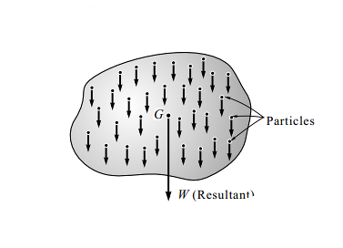
Centre of Gravity of a body
The Centre of gravity is a theoretical point in the body where the body’s total weight is thought to be concentrated.
It is important to know the centre of gravity because it predicts the behaviour of a moving body when acted on by gravity.
It is also useful in designing static structures such as buildings and bridges.
In a uniform gravitational field, the centre of gravity is identical to the centre of mass. Yet, the two points do not always coincide.
For the Moon, the centre of mass is very close to its geometric centre. However, its centre of gravity is slightly towards the Earth due to the stronger gravitational force on the Moon’s near side.
Fig. 2 Centre of gravity of body^{[1]}
https://www.youtube.com/shorts/BSvl7bgPLz4?feature=share
https://www.youtube.com/watch?v=dxC_GuLNiAs&list=PPSV

Slide 6
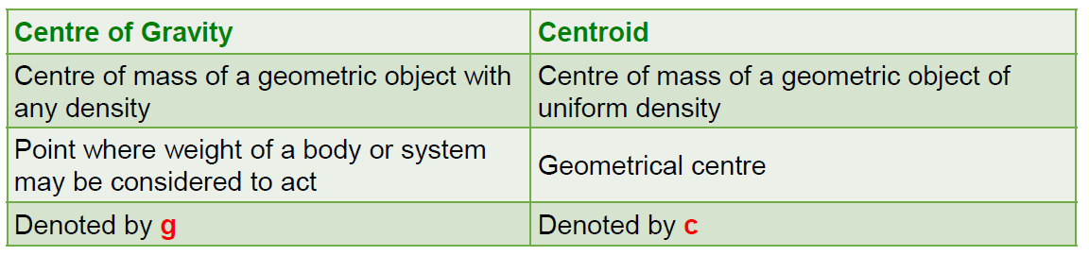
Centre of Gravity vs. Centroid

Slide 7
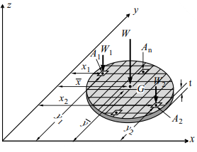
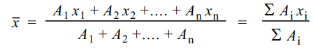
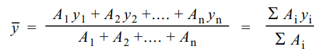
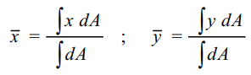
The plane figures (like triangle, quadrilateral, circle etc.) have only areas, but no mass. The center of area of such figures is known as centroid.
Fig. 3 Centre of gravity of flat plate^{[1]}

Slide 8
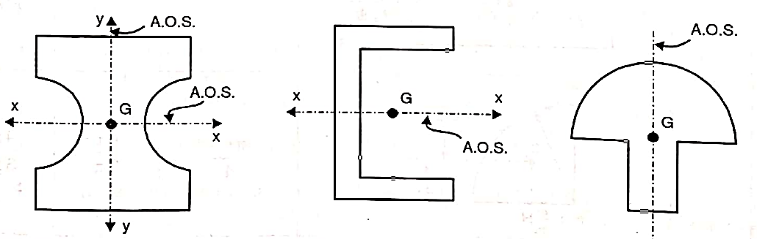
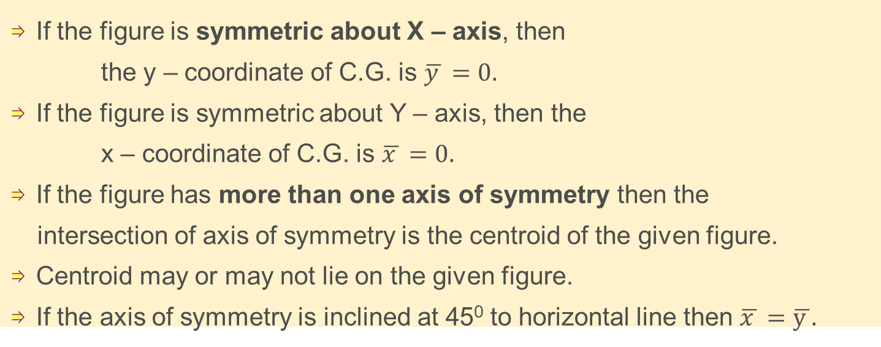
Important points
Centroid is the geometrical centre of the figure.
For the symmetric figure, centroid lies on the axis of symmetry.
If the figure is symmetric about X – axis, then
the y – coordinate of C.G. is $\overline{y }=0.$
If the figure is symmetric about Y – axis, then the
x – coordinate of C.G. is $\overline{x }=0.$
If the figure has more than one axis of symmetry then the
intersection of axis of symmetry is the centroid of the given figure.
Centroid may or may not lie on the given figure.
If the axis of symmetry is inclined at 45⁰ to horizontal line then $\overline{x }=\overline{y }.$

Slide 9
Important points

Slide 10
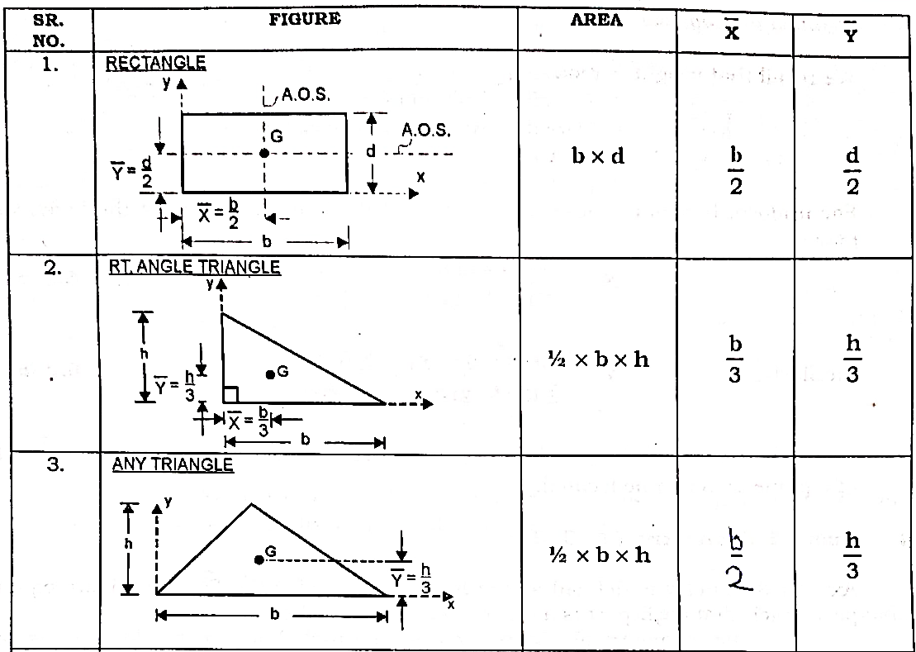

Slide 11
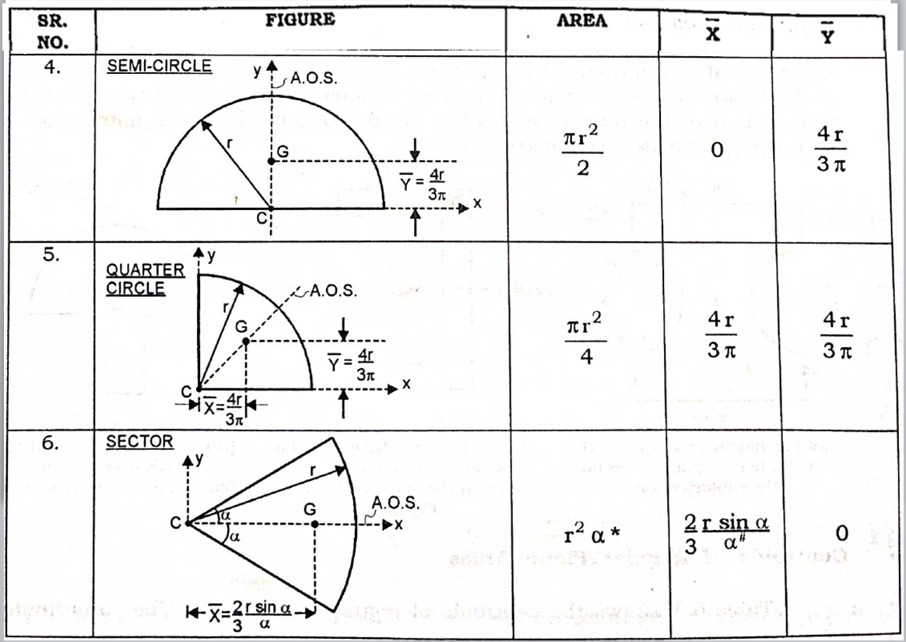

Slide 12
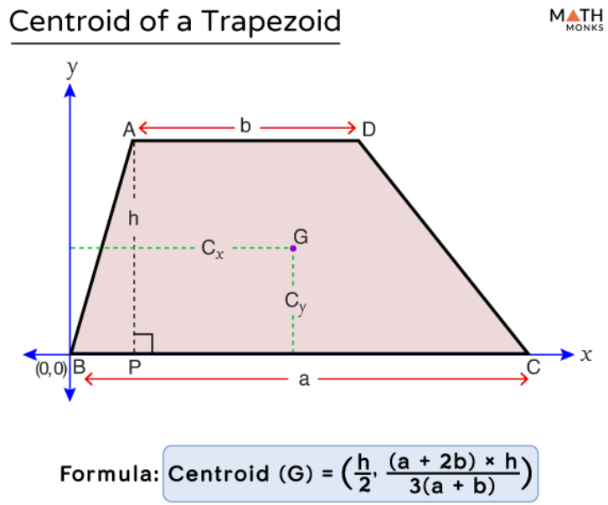
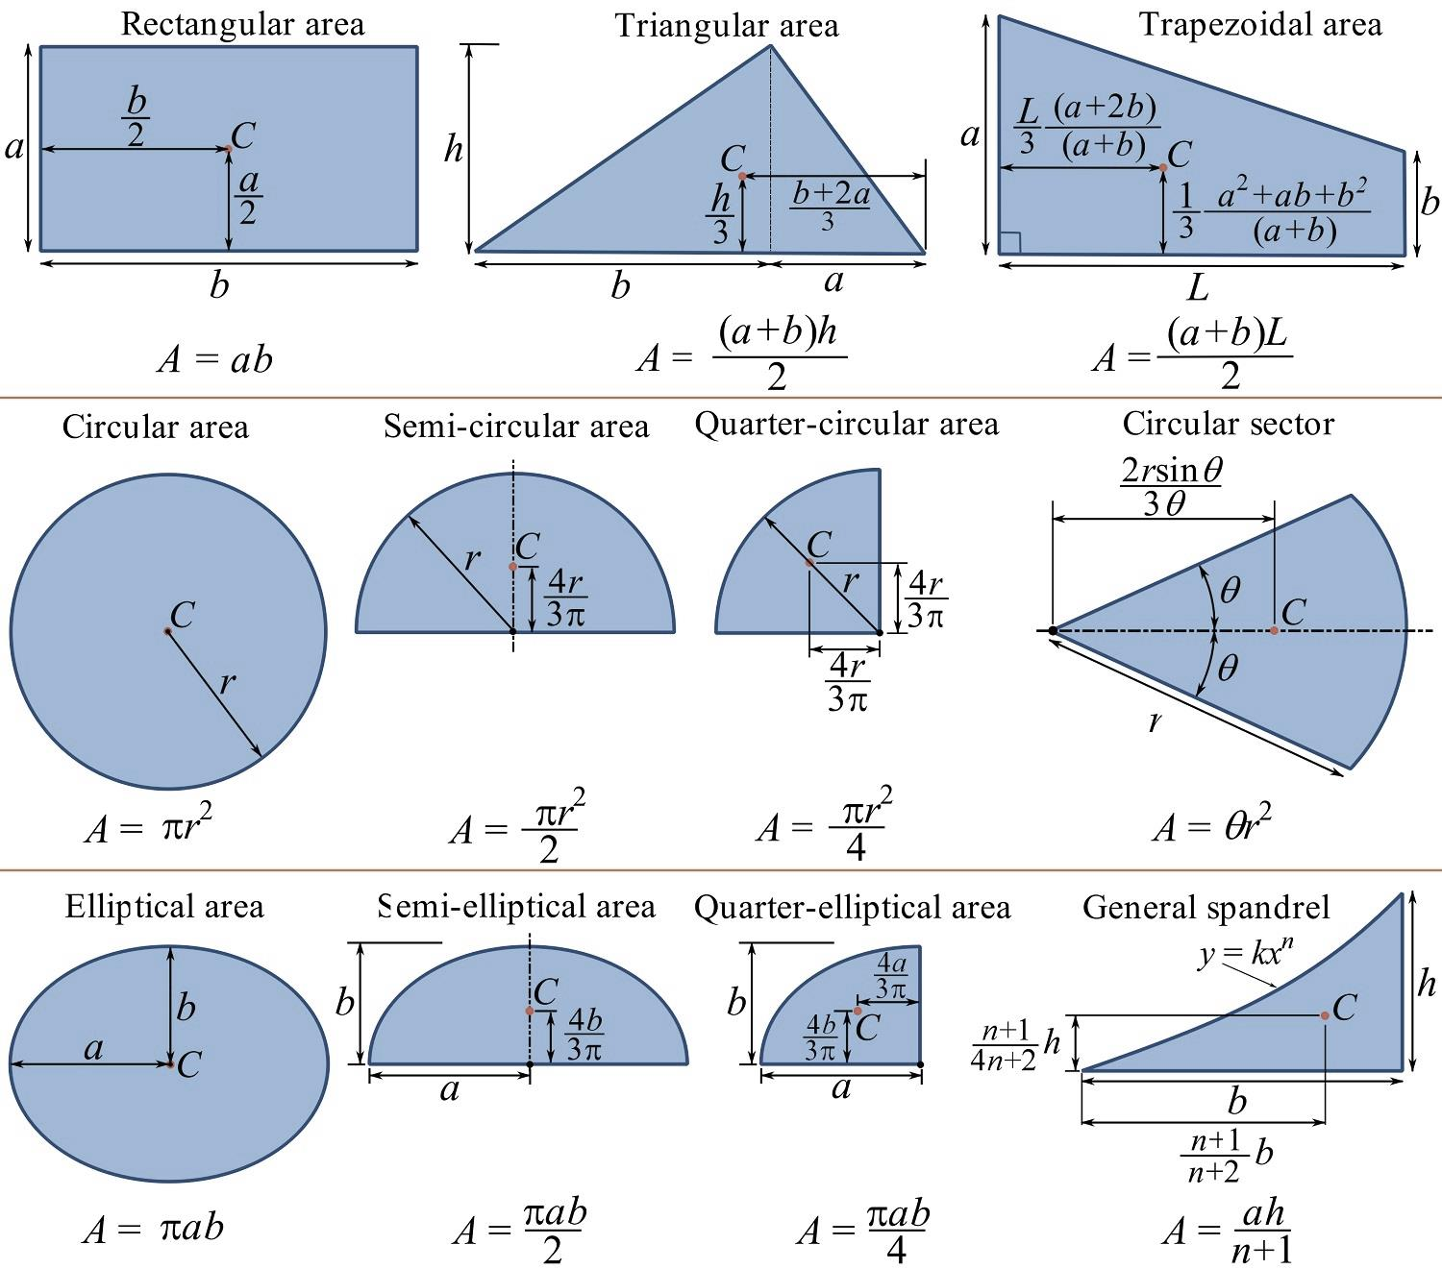
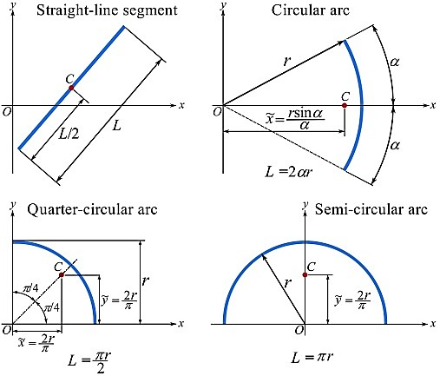

Slide 13
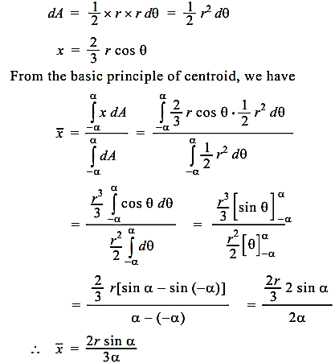
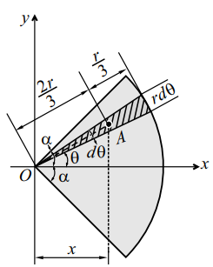
Centroid of Sector of a circle
The location of centroid of the elementary sector A as shown in Fig. 4
Fig. 6 Centroid of sector of a circle^{[1]}

Slide 14
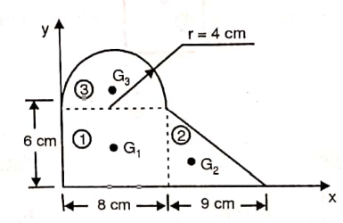
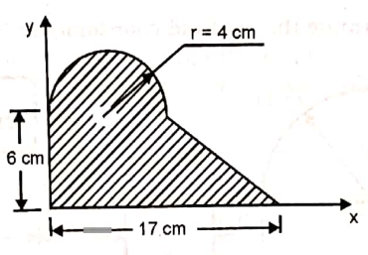
Numerical on Centroid of composite lamina
Q. 1. Determine the centroid of the shaded portion.
Fig. 7 Centroid of composite figure 5.88,3.91

Slide 16
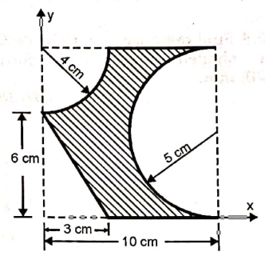
Q. 2. Determine the centroid of the shaded portion.
Fig. 8 Centroid of composite figure^{[2]}
Numerical on Centroid of composite lamina

Slide 18
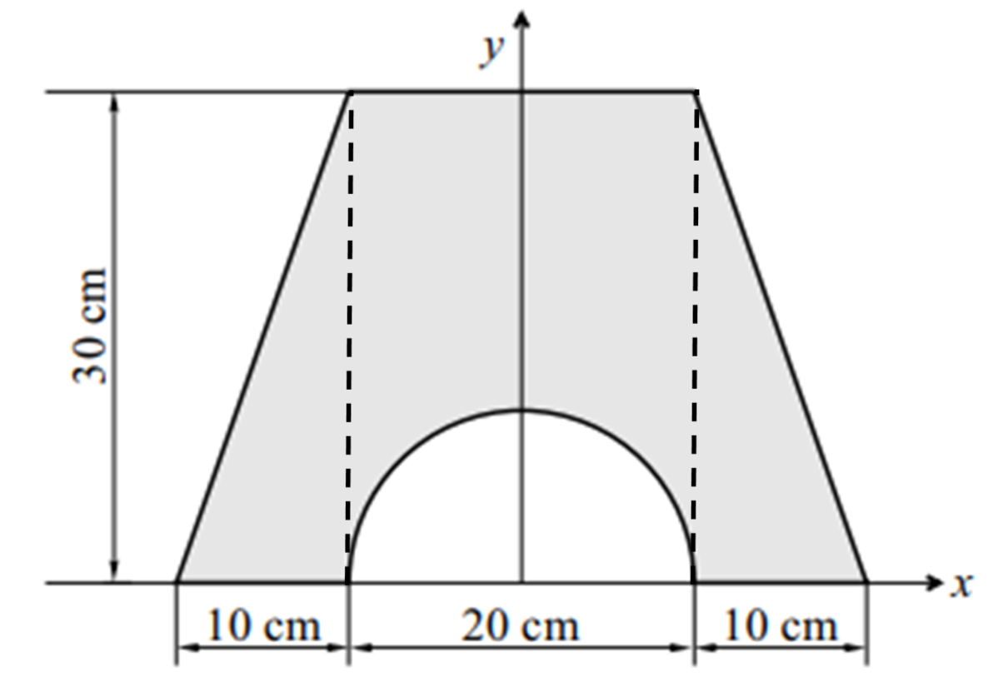
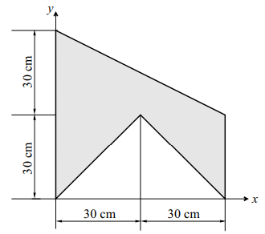
Q.3. Determine the centroid of the shaded portion.
(A)
(B)
Fig. 9 Centroid of composite figure^{[1]}
Numerical on Centroid of composite lamina

Slide 19
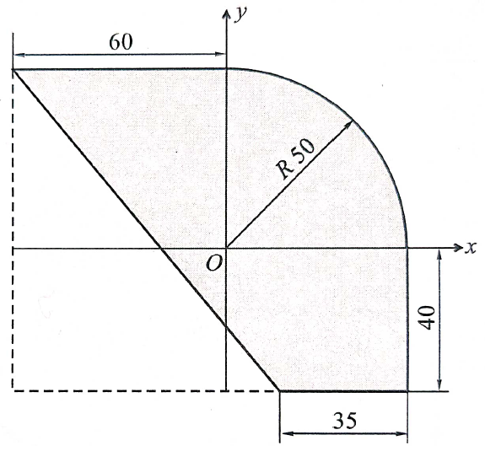
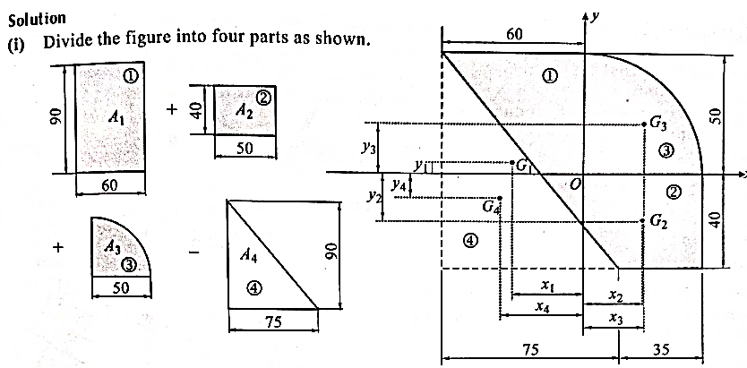
Q. 4. Determine the centroid of the shaded portion.(Ans. X=7.98, Y=10.4)
Numerical on Centroid of composite lamina

Slide 20
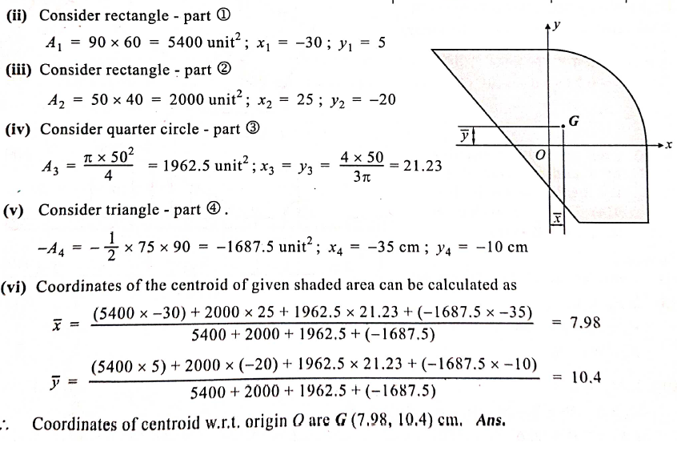

Slide 21
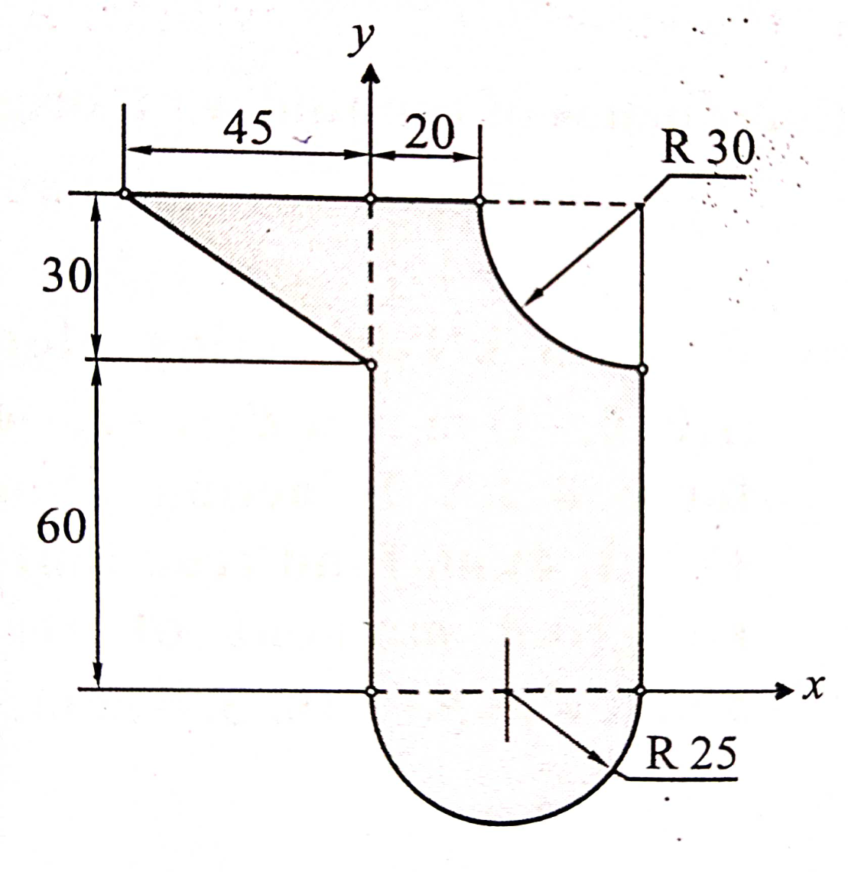
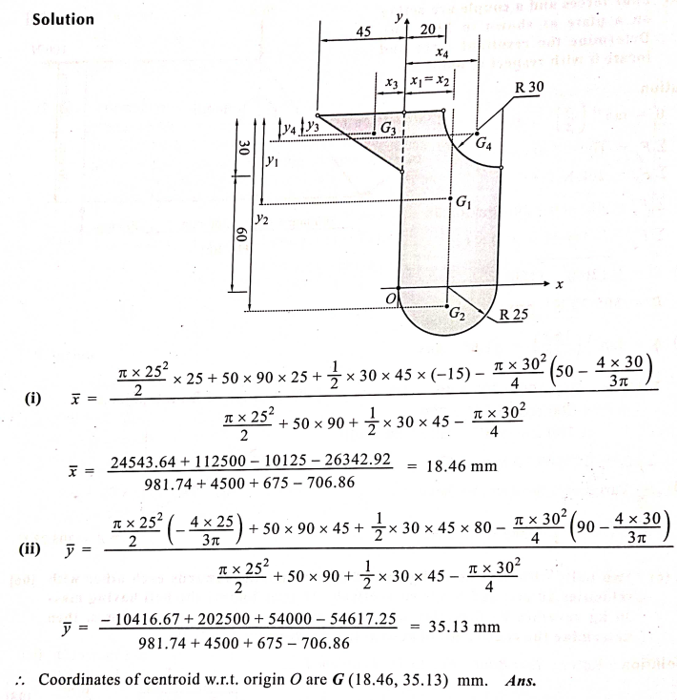
Q. 4. Determine the centroid of the shaded portion.
Ans: X= 18.46, Y= 35.13

Slide 22
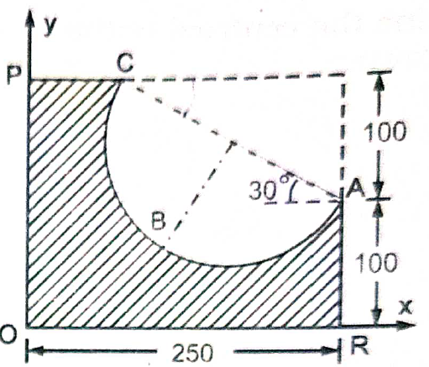
Q. 4. Determine the centroid of the shaded portion.
Ans: X= 9.176, Y= 6.937

Slide 23
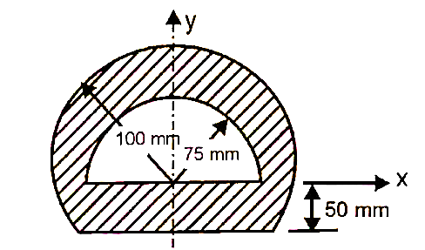
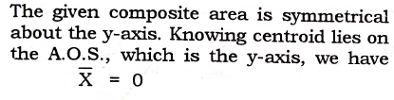
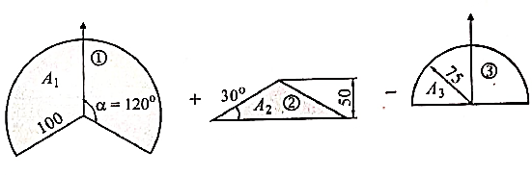
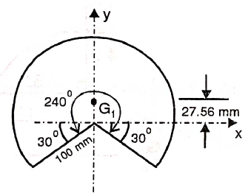
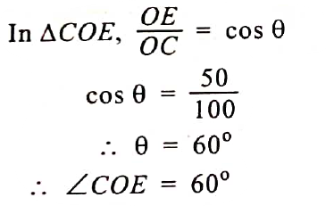
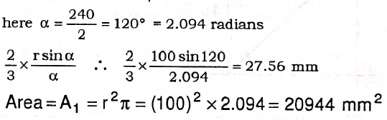
Centroid of composite lamina
A semi-circular section is removed from the plane area as shown. Determine the centroid of the remaining shaded section (Ans. X=0, Y= 9.239)

Slide 24
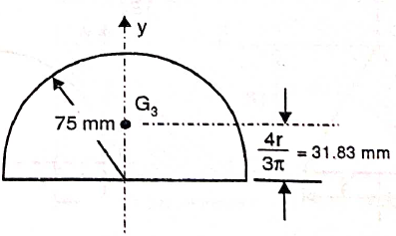
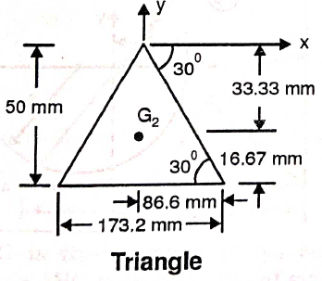
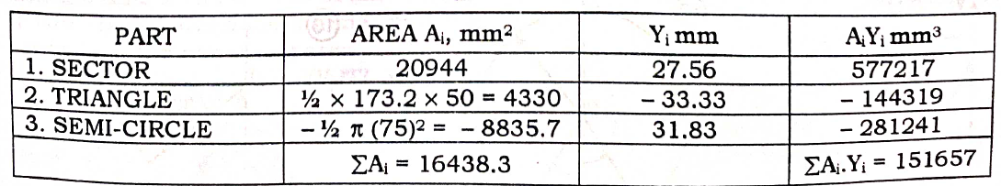

Slide 25
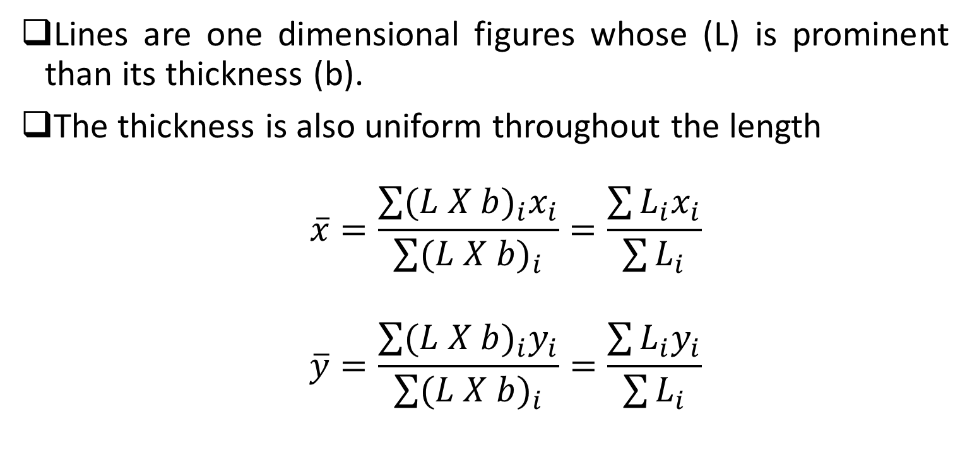
Centroid of lines
Lines are one dimensional figures whose (L) is prominent than its thickness (b).
The thickness is also uniform throughout the length
$$\overline{x}=\frac{\sum{{(L X b)}_{i}x_{i}}}{\sum{{(L X b)}_{i}}}=\frac{\sum{L_{i}x_{i}}}{\sum{L_{i}}}$$
$$\overline{y}=\frac{\sum{{(L X b)}_{i}y_{i}}}{\sum{{(L X b)}_{i}}}=\frac{\sum{L_{i}y_{i}}}{\sum{L_{i}}}$$

Slide 26
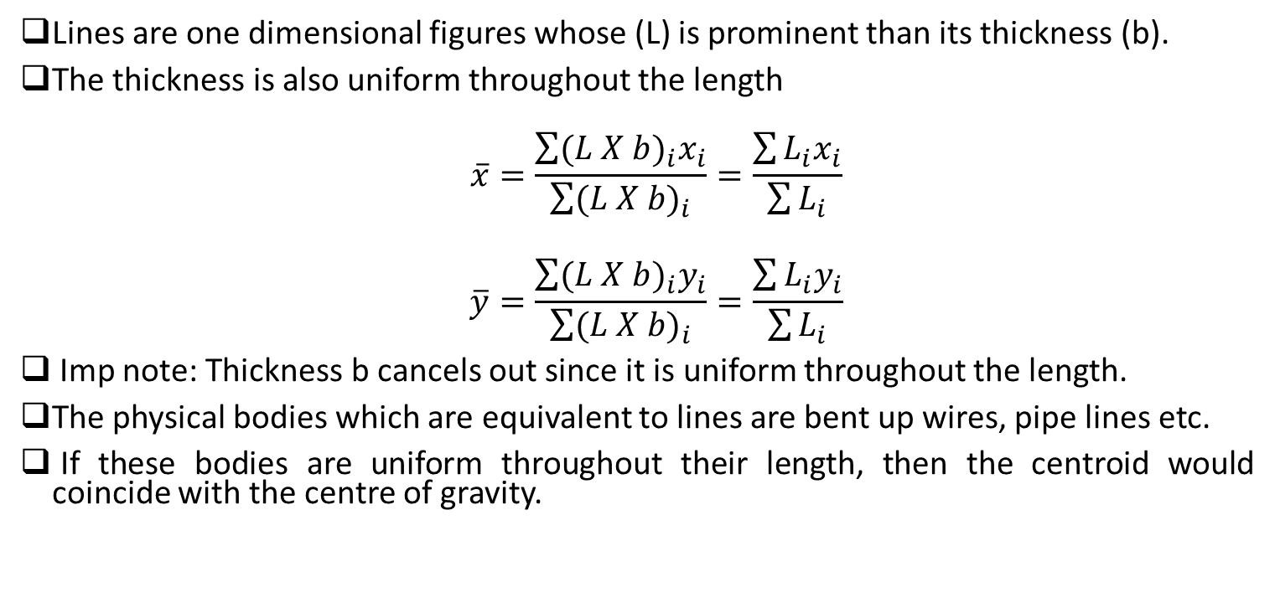
Centroid of lines
Lines are one dimensional figures whose (L) is prominent than its thickness (b).
The thickness is also uniform throughout the length
$$\overline{x}=\frac{\sum{{(L X b)}_{i}x_{i}}}{\sum{{(L X b)}_{i}}}=\frac{\sum{L_{i}x_{i}}}{\sum{L_{i}}}$$
$$\overline{y}=\frac{\sum{{(L X b)}_{i}y_{i}}}{\sum{{(L X b)}_{i}}}=\frac{\sum{L_{i}y_{i}}}{\sum{L_{i}}}$$
Imp note: Thickness b cancels out since it is uniform throughout the length.
The physical bodies which are equivalent to lines are bent up wires, pipe lines etc.
If these bodies are uniform throughout their length, then the centroid would coincide with the centre of gravity.

Slide 27
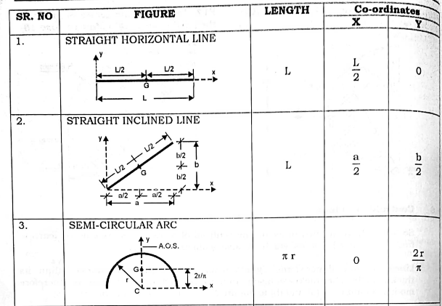
Centroid of lines

Slide 28
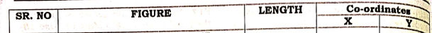
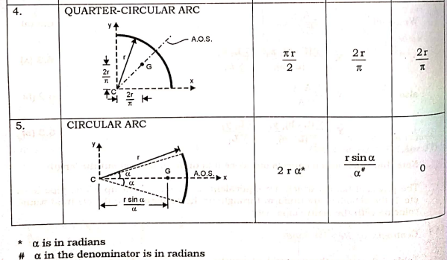
Centroid of lines

Slide 29


Numerical on Centroid of lines
Q. 6 A thin homogeneous wire of uniform cross-section is bent into shape OABCO as shown. Determine its centroid.

Slide 30





Slide 31


Q A thin homogeneous wire of uniform cross-section is bent into shape ABCDE as shown. Determine its centroid

Slide 32





Slide 33
References
Engineering Mechanics, N. H. Dubey, Mc Graw Hill Education (India) Pvt. Ltd., page no: 5.1 to 5.26
Engineering Mechanics, M. D. Dayal, page no. 129 to 151.

